Slide 1

WAY TO ENTERPRISE
AWS
VTI ACADEMY
Author: duy.nguyenngoc1@vti.com.vn

Slide 2
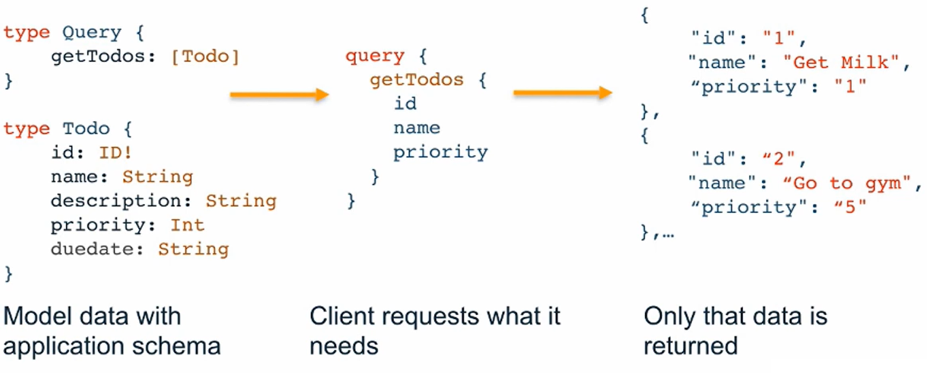
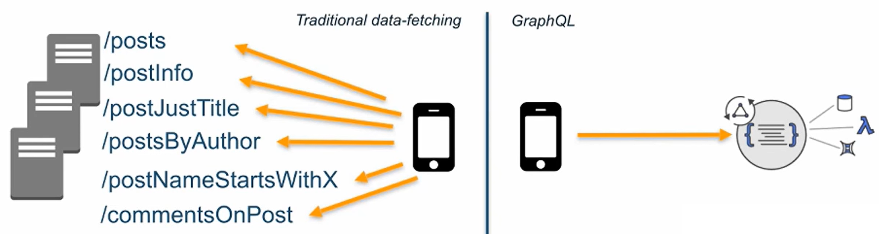
GraphQL
GraphQL is a query language for APIs, instead of Rest API in the future
Single GraphQL endpoint
Support Realtime, Offline, Batching, Pagination, Relation, Aggregation, Search
Tutorial: https://graphql.org

Slide 3
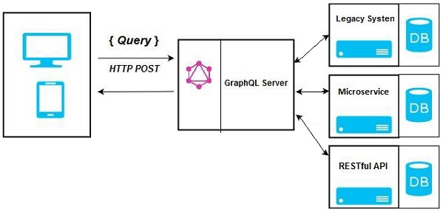
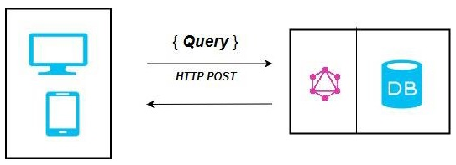
GraphQL
Helps develop applications faster
Front-end developers connect to single GraphQL endpoint to query multiple databases, APIs, microservices
Connect to Database
Integrating Existing Systems

Slide 4
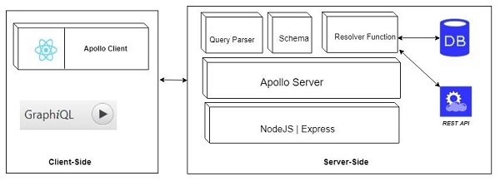
GraphQL
Components

Slide 5
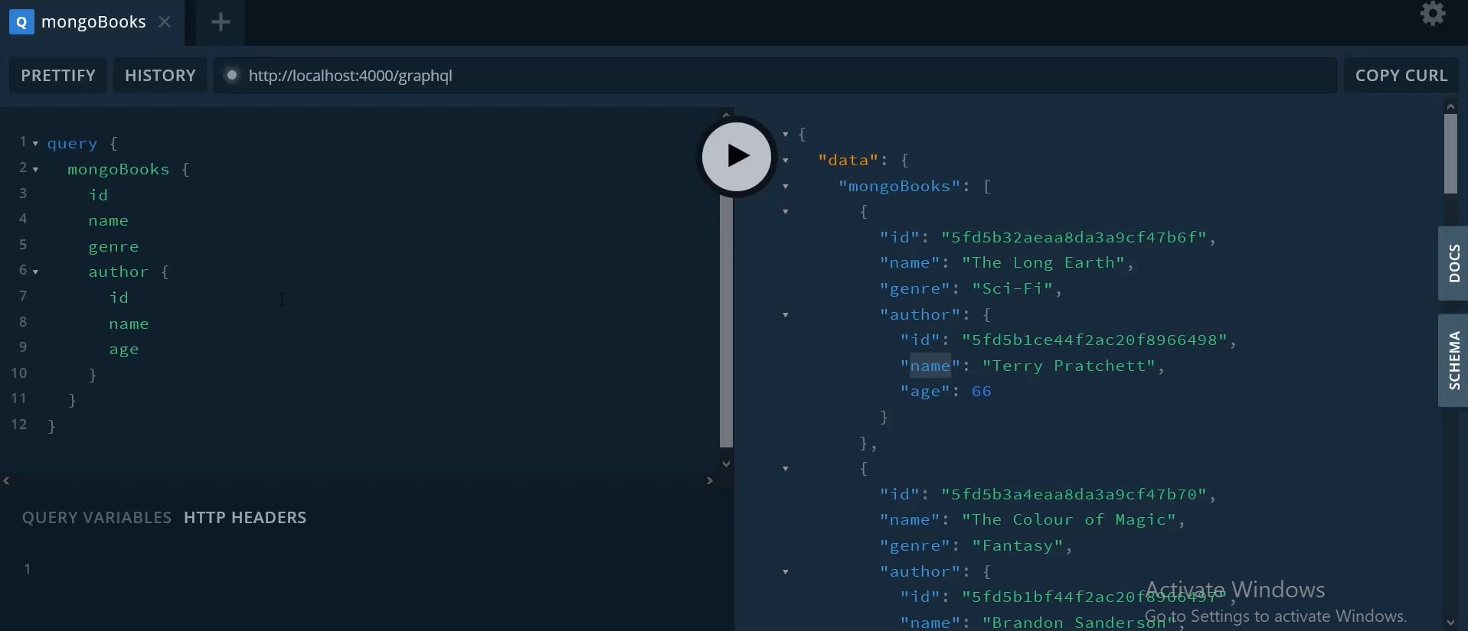
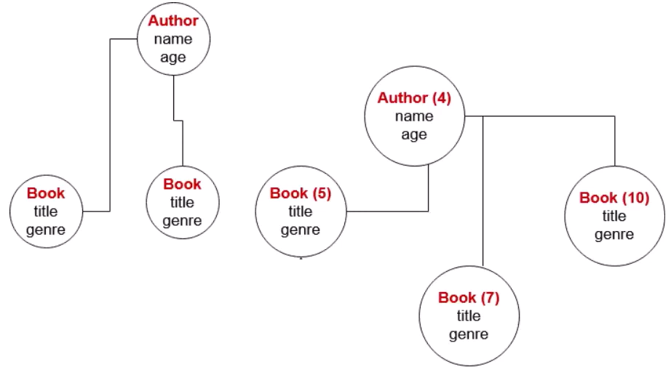
GraphQL
Demo
  https://www.youtube.com/watch?v=AEptYkblFg8&list=PLKzNGvIJtUDZt5GlzARgHUVFaTzfQytJV&index=2

Slide 6
Assignment
  Self-practice

Slide 7
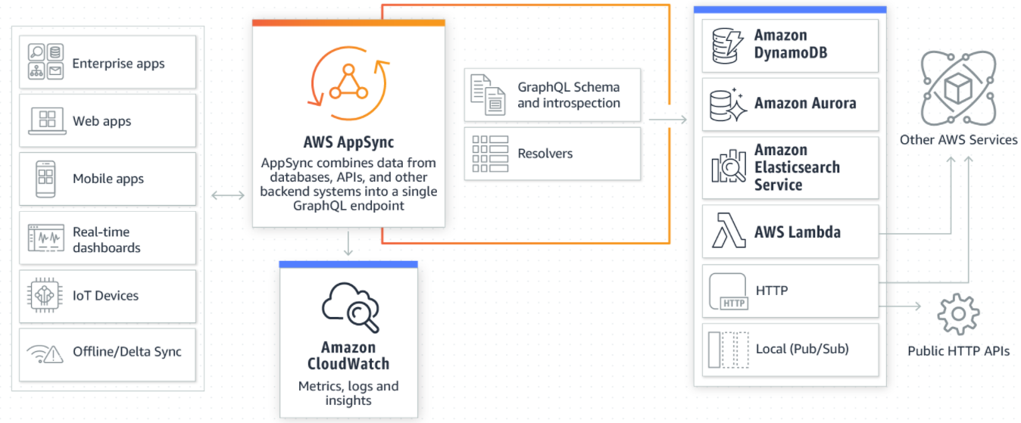
AppSync Service
Store and sync data across mobile & web apps with real-time subscriptions and offline data
Adding caches to improve performance
Using GraphQL
Usecases
  Realtime application (Multi-player games, Chat application, Shared whiteboards)
  Offline application
Tutorial: https://docs.aws.amazon.com/appsync/latest/devguide/what-is-appsync.html

Slide 8
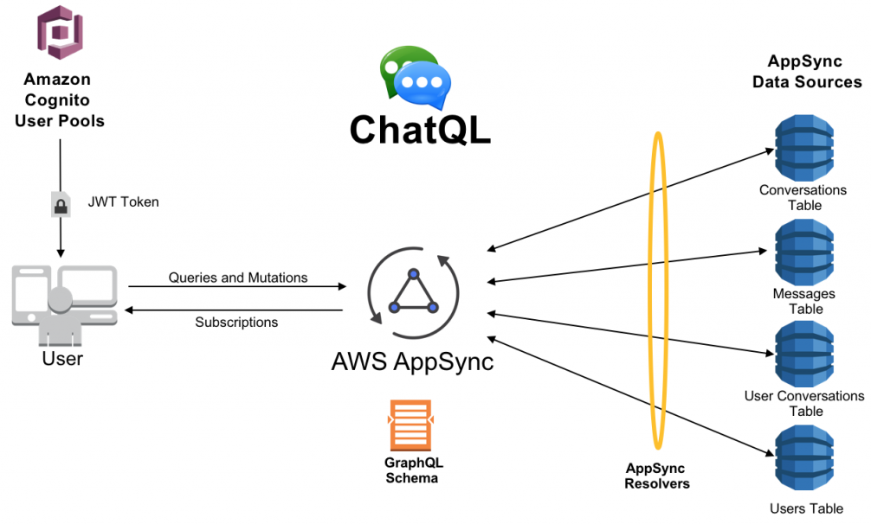
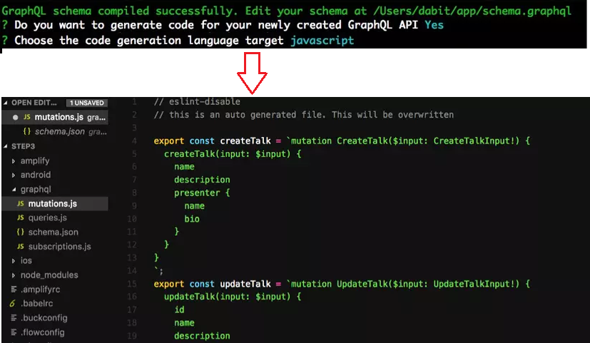
AppSync Service
Integrations with DynamoDB / Lambda, Cognito user pools for fine-grained access control
Client Code can be generated automatically
Automatically scale
Generate code

Slide 9
AppSync Service
Demo
  https://youtu.be/olAPj6EIlag?t=1460

Slide 10
Q & A
Copyright © VTI Academy All Rights Reserved

